Slide 1
Computer Organization and Design
Processor
Exceptions and Interrupts
[adapted from Mary Jane Irwin slides]

Slide 2
MIPS ISA for I/O
Coprocessor 0 records the information the software needs to handle exceptions (including interrupts)
  EPC (register 14) – holds the address+4 of the instruction that was executing when the exception occurred
  Status (register 13) – exception mask and enable bits
    Intr Mask = 1 bit for each of 6 hw and 2 sw exception levels (1 enables exception at that level, 0 disables them)
    User mode = 0 if running in kernel mode when exception occurred; 1 if running in user mode (fixed at 1 in SPIM)
    Excp level = set to 1 (disable exceptions) when an exception occurs; should be reset by exception handler when done
    Intr enable = 1 if exception are enabled; 0 if disabled
15
8
4
1
0
Intr Mask
User mode
Intr enable
Excp level

Slide 3
MIPS ISA, Con’t
  Cause (register 12) – exception pending and type bits
    PI: bits set if exception occurs but not yet serviced
      so can handle more than one exception occurring at same time, or records exception requests when exception are disabled
    Exception code: encodes reasons for exception
      0 (INT) → external interrupt (I/O device request)
      4 (AdEL) → address error trap (load or instr fetch)
      5 (AdES) → address error trap (store)
      6 (IBE) → bus error on instruction fetch trap
      7 (DBE) → bus error on data load or store trap
      8 (Sys) → syscall trap
      9 (Bp) → breakpoint trap
      10 (RI) → reserved (or undefined) instruction trap
      12 (Ov) → arithmetic overflow trap
31
15
8
6
2
Branch
delay
Pending exception (PI)
Exception
code
PI3 = recv intr
PI2 = trans intr
PI2 = trans intr

Slide 4
MIPS Exception Return Instruction
Exception return – sets the Excp level bit in coprocessor 0’s Status register to 0 (reenabling exception) and returns to the instruction pointed to by coprocessor 0’s EPC register
eret #return from exception
0x10 1 0 0 0 0x18

Slide 5
Example I/O Interrupts in SPIM - Enable
li $t0, 0xffff0000 #recv ctrl
li $t1, 0xffff0004 #recv data
li $t2, 0xffff0008 #trans ctrl
li $t3, 0xffff000c #trans data
mfc0 $t4, $13 #Cause reg
andi $t4, $t4, 0xffff00ff #clear Pending interrupt
mtc0 $t4, $13 #(PI) bits in Cause reg
li $t4, 0x2
sw $t4, 0($t0) #enable recv interrupts
sw $t4, 0($t2) #enable trans interrupts
mfc0 $t4, $12 #Status reg
ori $t4, $t4, 0xff01 #enable intr and mask
mtc0 $t4, $12 #in Status reg
#do something useful while I/O is taking place
#when I/O interrupts occur transfer control to
#exception handler (at address 0x80000180)

Slide 6
Example I/O Interrupts in SPIM - Handler
.ktext 0x80000180
mfc0 $t4, $13 #get ExcpCode from Cause
srl $t5, $t4, 2
andi $t5, $t5, 0x1f #ExcpCode in $t5, if 0
bne $t5, $zero, excp #then I/O intr has occurred
ck_recv:
andi $t5, $t4, 0x800 #check for PI3 (input), beq $t5, $zero, ck_trans #if 0,then trans intr
I1: lw $t5, 0($t0) #check recv ready
andi $t5, $t5, 1
beq $t5, $zero, no_recv_ready
lw $t6, 0($t1) #input character into $t6
li $t7 1
andi $t4, $t4, 0xfffff7ff #clear PI3 bit in Cause reg
mtc0 $t4, $13

Slide 7
Example I/O Interrupts in SPIM – Handler, con’t
ck_trans:
beq $t7, $zero, ret_hand #no character to echo yet
andi $t5, $t4, 0x400 #check for PI2 (output)
beq $t5, $zero, ret_hand #if 0, then no trans intr
I2: lw $t5, 0($t2) #check trans ready
andi $t5, $t5, 1
beq $t5, $zero, no_trans_ready
sw $t6, 0($t3) #echo character to display
mfc0 $t4, $13
andi $t4, $t4, 0xfffffbff #clear PI2 bit in Cause reg
mtc0 $t4, $13
ret_hand:
mfc0 $t4, $12 #Status reg
ori $t4, $t4, 0xff01 #enable intr and mask
mtc0 $t4, $12 #in Status reg
eret #return from intr

Slide 8
Exceptions in General
System
Exception
Handler
user program
Exception
normal control flow: sequential, jumps, branches, calls, returns
return from
exception
Exception = unprogrammed control transfer
  system takes action to handle the exception
    must record the address of the offending or next to execute instruction and save (and restore) user state
  returns control to user after handling the exception

Slide 9
Two Types of Exceptions
Interrupts
  caused by external events (i.e., request from I/O device)
  asynchronous to program execution
  may be handled between instructions
  simply suspend and resume user program
Traps
  caused by internal events
    exceptional conditions (e.g., arithmetic overflow, undefined instr.)
    errors (e.g., hardware malfunction, memory parity error)
    faults (e.g., non-resident page – page fault)
  synchronous to program execution
  condition must be remedied by the trap handler
  instruction may be retried (or simulated) and program continued or program may be aborted

Slide 10
Additions to MIPS ISA for Interrupts
Control signals to write EPC (EPCWrite), Cause and Status (Cause&StatusWrite)
Hardware to record the type of interrupt in Cause
Modify the finite state machine so that
  the address of interrupt handler (8000 0180_{hex}) can be loaded into the PC, so must increase the size of PC mux
  and save the address of the next instr in EPC

Slide 11
Interrupt Modified Multicycle Datapath
Interrupt
EPCWrite
PCWriteCond
Cause&StatusWrite
PCWrite
PCSource
IorD
ALUOp
MemRead
Control
ALUSrcB
MemWrite
ALUSrcA
EPC
MemtoReg
RegWrite
IRWrite
RegDst
Status
8000 0180
Cause
PC[31-28]
Instr[31-26]
Instr[25-0]
Shift
left 2
3
2
0
1
PC
0
Address
Memory
Read Addr 1
0
IR
Read
Data 1
A
1
Register
File
1
zero
Read Data
(Instr. or Data)
Read Addr 2
0
ALUout
Write Addr
ALU
Write Data
1
Read
Data 2
B
0
1
Write Data
4
MDR
1
0
2
Instr[15-0]
Sign
Extend
Shift
left 2
3
32
ALU
control
Instr[5-0]

Slide 12
Interrupt Modified Multicycle Datapath
Interrupt
EPCWrite
PCWriteCond
Cause&StatusWrite
PCWrite
PCSource
IorD
ALUOp
MemRead
Control
ALUSrcB
MemWrite
ALUSrcA
EPC
MemtoReg
RegWrite
IRWrite
RegDst
Status
8000 0180
Cause
PC[31-28]
Instr[31-26]
Instr[25-0]
Shift
left 2
3
2
0
1
PC
0
Address
Memory
Read Addr 1
0
IR
Read
Data 1
A
1
Register
File
1
zero
Read Data
(Instr. or Data)
Read Addr 2
0
ALUout
Write Addr
ALU
Write Data
1
Read
Data 2
B
0
1
Write Data
4
MDR
1
0
2
Instr[15-0]
Sign
Extend
Shift
left 2
3
32
ALU
control
Instr[5-0]

Slide 13
Interrupt Modified FSM
0
Decode
IorD = 0
MemRead;IRWrite
ALUSrcA = 0
ALUsrcB = 01
ALUOp = 00
PCSource = 00
PCWrite
Instr Fetch
1
ALUSrcA = 0
ALUSrcB = 11
ALUOp = 00
Start
(Op = R-type)
(Op = beq)
2
(Op = lw or sw)
(Op = j)
6
8
9
ALUSrcA = 1
ALUSrcB = 00
ALUOp = 01
PCSource = 01
PCWriteCond
ALUSrcA = 1
ALUSrcB = 10
ALUOp = 00
Execute
ALUSrcA = 1
ALUSrcB = 00
ALUOp = 10
PCSource = 10
PCWrite
(Op = lw)
(Op = sw)
3
Memory Access
5
7
MemWrite
IorD = 1
RegDst = 1
RegWrite
MemtoReg = 0
MemRead
IorD = 1
4
RegDst = 0
RegWrite
MemtoReg = 1
Write Back

Slide 14
Interrupt Modified FSM
0
Decode
IorD = 0
MemRead;IRWrite
ALUSrcA = 0
ALUsrcB = 01
ALUOp = 00
PCSource = 00
PCWrite
Instr Fetch
1
ALUSrcA = 0
ALUSrcB = 11
ALUOp = 00
Start
(Op = R-type)
(Op = beq)
2
(Op = lw or sw)
(Op = j)
6
8
9
ALUSrcA = 1
ALUSrcB = 00
ALUOp = 01
PCSource = 01
PCWriteCond
ALUSrcA = 1
ALUSrcB = 10
ALUOp = 00
Execute
ALUSrcA = 1
ALUSrcB = 00
ALUOp = 10
PCSource = 10
PCWrite
(Op = lw)
(Op = sw)
3
Memory Access
5
7
MemWrite
IorD = 1
RegDst = 1
RegWrite
MemtoReg = 0
MemRead
IorD = 1
Interrupt
pending?
Cause&StatusWrite
EPCWrite;PCWrite
IntrOrExcp = 0
PCSource = 11
4
11
RegDst = 0
RegWrite
MemtoReg = 1
Write Back

Slide 15
Additions to MIPS ISA for Traps
Control signals to write EPC (EPCWrite & IntrOrExcp), Cause and Status (Cause&StatusWrite)
Hardware to record the type of trap in Cause
Further modify the finite state machine so that
  for traps, record the address of the current (offending) instruction in the EPC, so must undo the PC = PC + 4 done during fetch

Slide 16
Trap Modified Multicycle Datapath
Trap
EPCWrite
PCWriteCond
IntrOrExcp
PCWrite
CauseWrite
PCSource
IorD
ALUOp
MemRead
Control
ALUSrcB
MemWrite
ALUSrcA
EPC
MemtoReg
RegWrite
IRWrite
RegDst
Status
8000 0180
Cause
PC[31-28]
Instr[31-26]
Instr[25-0]
Shift
left 2
3
2
0
1
PC
0
Address
Memory
Read Addr 1
0
IR
Read
Data 1
A
1
Register
File
1
zero
Read Data
(Instr. or Data)
Read Addr 2
0
ALUout
Write Addr
ALU
Write Data
1
Read
Data 2
B
0
1
Write Data
4
MDR
1
0
2
Instr[15-0]
Sign
Extend
Shift
left 2
3
32
ALU
control
Instr[5-0]

Slide 17
Trap Modified Multicycle Datapath
Trap
EPCWrite
PCWriteCond
IntrOrExcp
PCWrite
CauseWrite
PCSource
IorD
ALUOp
MemRead
Control
ALUSrcB
0
MemWrite
ALUSrcA
EPC
MemtoReg
RegWrite
1
IRWrite
RegDst
Status
8000 0180
Cause
PC[31-28]
Instr[31-26]
Instr[25-0]
Shift
left 2
3
2
0
1
PC
0
Address
Memory
Read Addr 1
0
IR
Read
Data 1
A
1
Register
File
1
zero
Read Data
(Instr. or Data)
Read Addr 2
0
ALUout
Write Addr
ALU
Write Data
1
Read
Data 2
B
0
1
Write Data
4
MDR
1
0
2
01
Instr[15-0]
Sign
Extend
Shift
left 2
3
32
ALU
control
Instr[5-0]

Slide 18
How Control Detects Two Traps
Undefined instruction (RI) – detected when no next state is defined in state 1 (decode) for the opcode value
  Define the next state value for all undefined op values as new state 10
Arithmetic overflow (Ov) – The overflow signal from the ALU is used in state 6 (if don’t want to complete RegWrite)
Need to modify the FSM in a similar fashion for remaining traps
  Challenge is to handle the interactions between instructions and exception-causing events so that the control logic remains small and fast
    Complex interactions makes the control unit the most challenging aspect of hardware design, especially in pipelined processors

Slide 19
Trap Modified FSM
0
Decode
IorD = 0
MemRead;IRWrite
ALUSrcA = 0
ALUsrcB = 01
ALUOp = 00
PCSource = 00
PCWrite
Instr Fetch
1
ALUSrcA = 0
ALUSrcB = 11
ALUOp = 00
Start
(Op = R-type)
(Op = beq)
(Op = other)
2
(Op = lw or sw)
(Op = j)
6
8
9
ALUSrcA = 1
ALUSrcB = 00
ALUOp = 01
PCSource = 01
PCWriteCond
ALUSrcA = 1
ALUSrcB = 10
ALUOp = 00
Execute
ALUSrcA = 1
ALUSrcB = 00
ALUOp = 10
PCSource = 10
PCWrite
(Op = lw)
(Op = sw)
No Overflow
3
Memory Access
5
7
MemWrite
IorD = 1
RegDst = 1
RegWrite
MemtoReg = 0
Overflow
MemRead
IorD = 1
Interrupt
pending?
Cause&StatusWrite
EPCWrite;PCWrite
IntrOrExcp = 0
PCSource = 11
4
11
RegDst = 0
RegWrite
MemtoReg = 1
Write Back

Slide 20
Trap Modified FSM
0
Decode
IorD = 0
MemRead;IRWrite
ALUSrcA = 0
ALUsrcB = 01
ALUOp = 00
PCSource = 00
PCWrite
Instr Fetch
1
ALUSrcA = 0
ALUSrcB = 11
ALUOp = 00
Start
(Op = R-type)
(Op = beq)
(Op = other)
2
(Op = lw or sw)
(Op = j)
6
8
9
ALUSrcA = 1
ALUSrcB = 00
ALUOp = 01
PCSource = 01
PCWriteCond
ALUSrcA = 1
ALUSrcB = 10
ALUOp = 00
Execute
ALUSrcA = 1
ALUSrcB = 00
ALUOp = 10
PCSource = 10
PCWrite
(Op = lw)
(Op = sw)
No Overflow
3
Memory Access
5
7
10
RegDst = 1
RegWrite
MemtoReg = 0
Cause&StatusWrite
ALUSrcA =0
ALUSrcB = 01
ALUOp = 01
EPCWrite;PCWrite
IntrOrExcp = 1
PCSource = 11
MemRead
IorD = 1
MemWrite
IorD = 1
Overflow
Interrupt
pending?
Cause&StatusWrite
EPCWrite;PCWrite
IntrOrExcp = 0
PCSource = 11
4
11
RegDst = 0
RegWrite
MemtoReg = 1
Write Back

Slide 21
Simplified Exception & Interrupt Handling
1. There is only one external asynchronous interrupt request.
2. The CPU deals with only three exceptions: arithmetic signed overﬂow, unimplemented instruction, and system call.
3. For exceptions, the address of the current instruction that generates the exception is saved to EPC; for interrupt, the address of the next instruction is saved to EPC.

Slide 22
Simplified Exception & Interrupt Handling, Con’t
4. The polled interrupt is adopted. The entry address of the interrupt/exception handler is 0x00000008.
5. In response to an interrupt or an exception, the content of the Status register is shifted to the left by 4 bits in order to save previous settings of the Status register and disable further interrupts.
6. When returning from the interrupt/exception handler, the content of the Status register is shifted to the right by 4 bits in order to restore the previous settings of the Status register.

Slide 23
CPU response to an interrupt or an exception
1. Update the ExcCode feld of the Cause register.
2. Shift the contents of the Status register to the left by 4 bits.
3. Save the return address to EPC.
4. Jump to the interrupt/exception handler.

Slide 24
CPU response to an interrupt or an exception (cont.)
For an interrupt request, the CPU also needs to issue an interrupt acknowledge signal to the device that generates the interrupt.
In the interrupt/exception handler, the CPU performs what it needs to do
based on the ExcCode field of the Cause register and finally executes the eret instruction to return to the interrupted program.

Slide 25
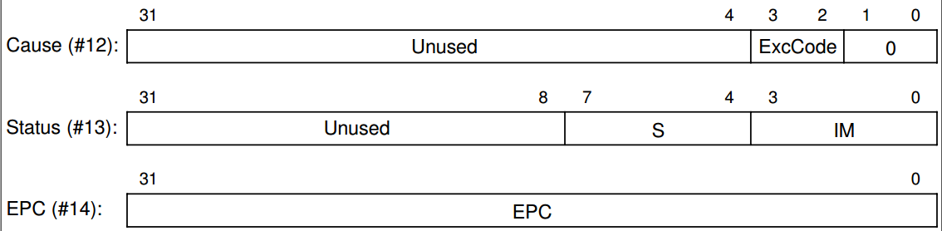
Registers related to exceptions and interrupts
The bits 0, 1, 2, and 3 in the IM field of the Status register are the mask control bits of interrupt, system call, unimplemented
instruction, and arithmetic overﬂow, respectively.
A 1 in IM feld indicates that the corresponding
interrupt or exception is enabled; a 0 indicates that it is disabled. The S field is used for saving the
contents in IM field.

Slide 26
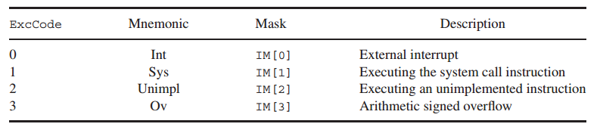
Definition of ExcCode and interrupt mask

Slide 27
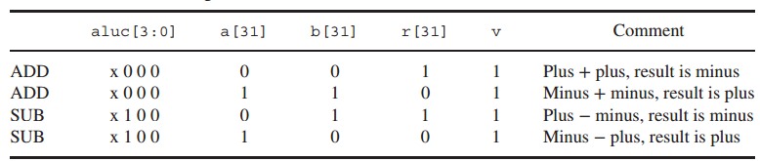
Overﬂow on signed add and subtract

Slide 28
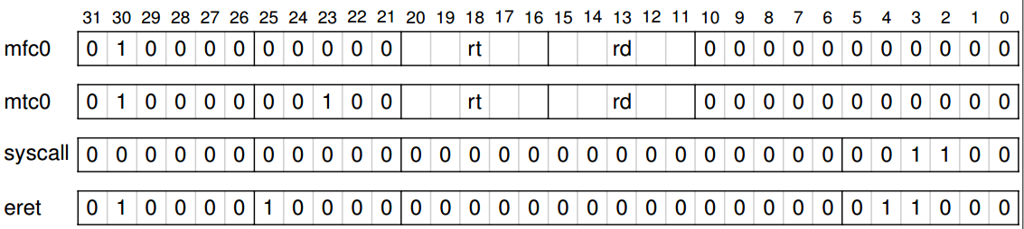
Format of exception- and interrupt-related instructions

Slide 29
Assignments
add the following instructions:
  mtc0, mfc0, syscall, eret
handle interrupt & exceptions:
  interrupt——only one external asynchronous interrupt request
    Use the counter overflow interrupt to change to the next data displayed on the Seven-segment display in one group of data.
  exceptions——overflow, reserved instruction (RI), syscall
    Use syscall to change to another group of data.
    Simply ignore RI & overflow in this lab
Pipelined CPU
  precise interrupt for pipelined CPU
  Do simulation first

Slide 30
Attention
Do simulation first
Prepare the .asm (& .coe ) files on your own!

